Slide 1
Real-Time Analytics
Brian Bønk Rueløkkke
Principal & Enterprise Architect, Fellowmind DK

Slide 2
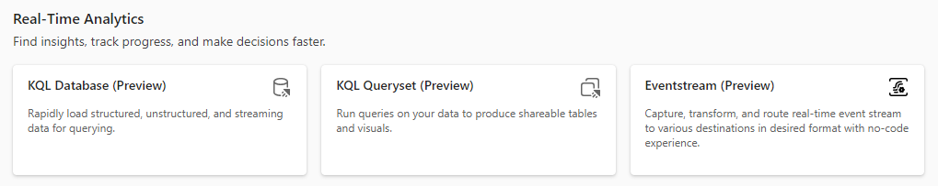
What is Real-Time Analytics in Fabric?
Real-Time Analytics is a fully managed big data analytics platform optimized for streaming, and time-series data.
It utilizes a query language and engine with exceptional performance for searching structured, semi-structured, and unstructured data.
Real-Time Analytics is fully integrated with the entire suite of Fabric products, for both data loading, data transformation, and advanced visualization scenarios.

Slide 3
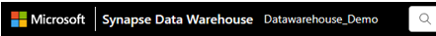
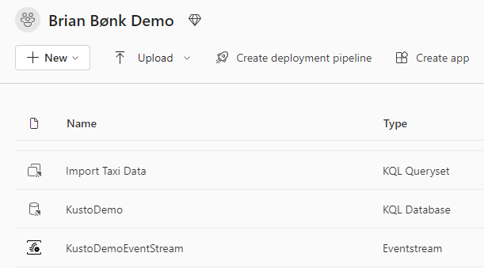
What is Real-Time Analytics in Fabric?
Real-Time Analytics is labelled as 3 different services in the Type column.
KQL Database
KQL Queryset
Eventstream
It is also possible to use Jupyter Notebooks in the work with Real-Time Analytics.
A KQL Queryset cannot exist without a connection to a KQL Database.
The Eventstream service is more or less an EventHub service with an easy to access UI.
Fabric workspace

Slide 4


Real-Time Analytics vs. Azure Data Explorer
Real-Time Analytics is the same engine as Azure Data Explorer. But the service in 100% SaaS with no possibility to configure special elements as you can in Azure Data Explorer.
The storage and compute is still the Engine V3 from the Kusto team in Microsoft. There is a possibility to copy data directly to your OneLake from the KQL database.
Other things like VNET, Managed Keys, ADX Dashboards are not yet available in the Fabric experience.
KQL Database
Lakehouse
Copy
V3 engine
Storage
Compute

Slide 5
Time to try it out
Create KQL database
Make data available in OneLake
Get data from Eventstream
Load data from Blob storage
Explore data using KQL and SQL
Advanced analytics using KQL
Build a Power BI report

